Slide 1
My Journal To Python

Slide 2
AGENDA
Python
Input and output: input() and print()
Data types: numerisc, strings, list , dict
Operators ON data type:
CONTROLS : IF- | IF –ELSIF |-F-ELSE
LOOP: FOR |WHILE | RANGE() | BREAK | CONTINUE
FUNCTION:
PARAMETERS(ARGUMETNS)
RECURSIVE FUNCTION
LAMBDA FUNCTION

Slide 3
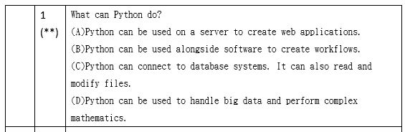
ＰＹＴＯＨＮ

Slide 4
Data types: Dictionary
Dictionaries are used to store data values in key:value pairs.
A dictionary is a collection which is ordered*, changeable and do not allow duplicates.
As of Python version 3.7, dictionaries are ordered.
In Python 3.6 and earlier, dictionaries are unordered.
Dictionaries are written with curly brackets, and have keys and values:
thisdict = {
"brand": "Ford",
"model": "Mustang",
"year": 1964
}
print(thisdict)

Slide 5
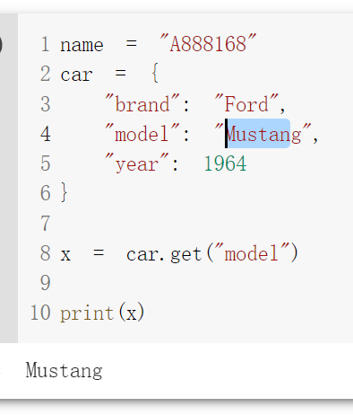
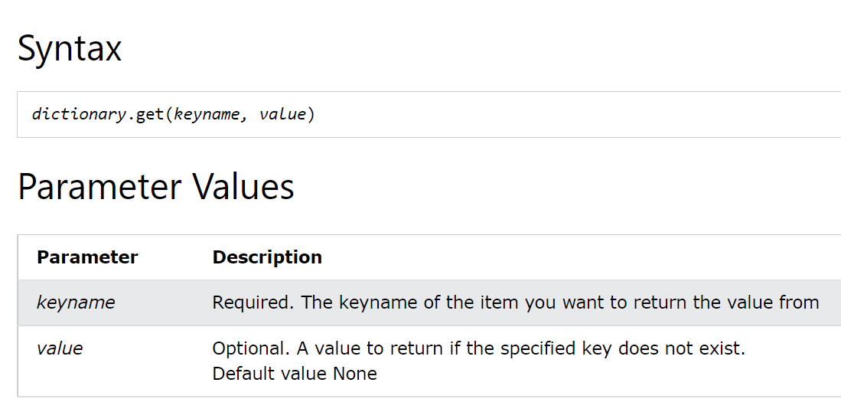
get()

Slide 6
